Slide 2
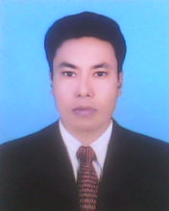
Introduction
I am Md.Nurmujahid Biswas
Assistant Teacher M.S.S (Sociology)
Ratandia R.K. Model High School
Kalukhali, Rajbari.
Email:raisha@gmail.com
Mobile:01714665780

Slide 3
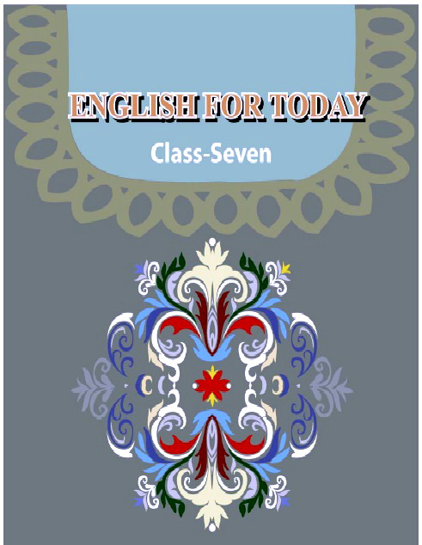
Unit: Five
Lesson: 05

Slide 4
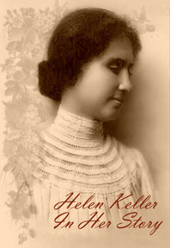
Look at the picture and ask answer these question
Helen Keller was a famous humanitarian. She deeply cared for the people who were sick and injured. Begum Rokeya was a famous writer and social worker. She fought for woman’s cause throughout her life.
They are a Helen Keller and a Begum Rokeya
What do you know about their?
Who is they?

Slide 5
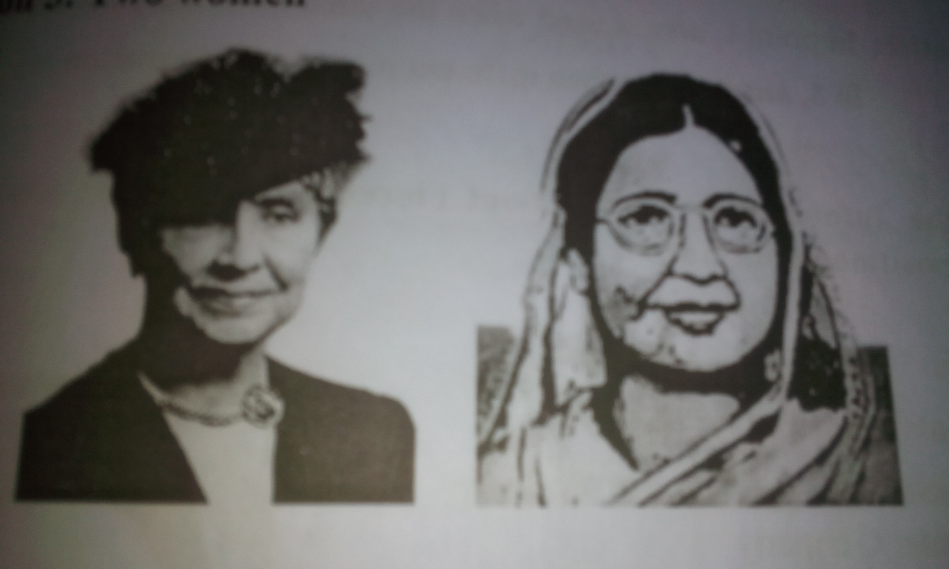
Today our Lesson is- Two Women

Slide 6
By the end of the lesson learners will be able
1. Complete the table;
2. Make sentence;
3. Write a composition;

Slide 7
A. Read the previous lessons (1-4) on Begum Rokeya And Helen Keller, and complete the table with information from the texts..
Pair work
10 - min:
 | Begum Rokeya | Helen Keller
1 born in | 1880 | 1880
2 nationality | Bengali ( at that time India) | American
3 family | Rich family- father Zaminder (landlord) married to an upper class man | not rich-source of income cotton plantation
4 physical condition | moral | blind, deaf and dump
5 education | Self educated, learnt Bangla and English from brother | formal education from school and College
6 aim in life | to establish women’s rights in society | to help disabled people to learn
7 achievements | a number of novels and short stories, establishing educational institutions | made learning easier for disabled people
8 death | 1932 | 1968

Slide 8
Individual work 8 min
B. Now read the completed chart and write one or two sentences for
each of the 8 points in the chart. Look at the examples.
Point 1: Begum Rokeya was born in 1880. Helen Keller was also born
in 1880.
Point 5: Begum Rokeya was self educated and learnt Bangla and
English from her brother. But Helen Keller got formal
education from school and college.

Slide 9
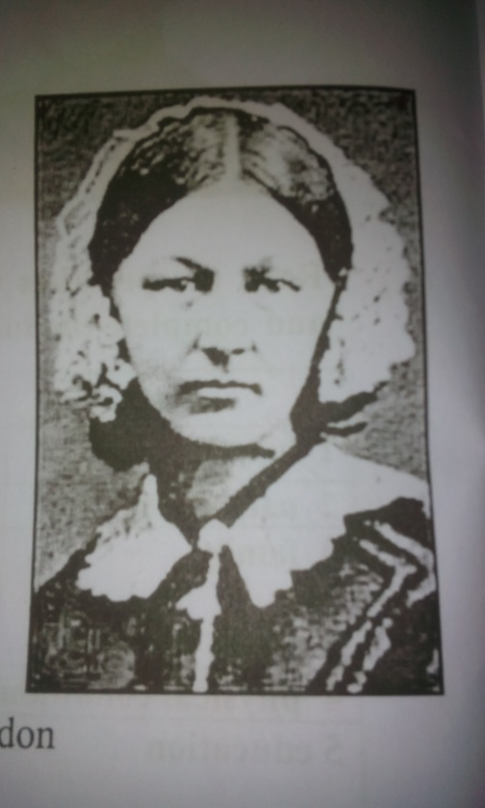
Group work 05 min
C. Use the information / facts about Florence Nightingale
and write a composition about her.
Born-1820. Florence, Italy
Parents- rich- father landlord
Studied nursing at Nurses’ Training Institute, Germany
First job- in a London hospital
Went to Turkey with a group of 38 nurses to work for the sick British soldiers during the Crimean (1853-56)
Worked day and night to help the wounded soldiers
Returend to England- Title: the Lady with the Lamp by the Times- role in nursing
Set up Nightingale School for nurses in London
Died-13 August 1910

Slide 10
Assessments
 | Begum Rokeya | Helen Keller
1 born in | 1880
2 nationality | Bengali ( at that time India)
3 family |  | not rich-source of income cotton plantation
4 physical condition | Moral | blind, deaf and dump
5 education | Self educated, learnt Bangla and English from brother
6 aim in life |  | to help disabled people to learn
7 achievements
8 death

Slide 11
Home Works
What have you learnt from the stories of these two women? How can you apply this in your life?

Slide 12
So that’S all for today
Stay well
Thank You
Good Bye

